Slide 1
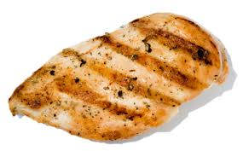
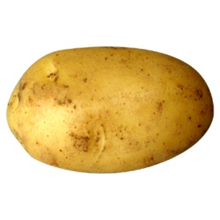
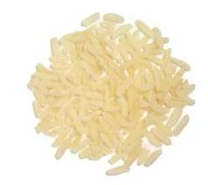
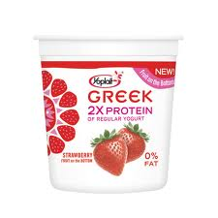
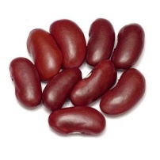
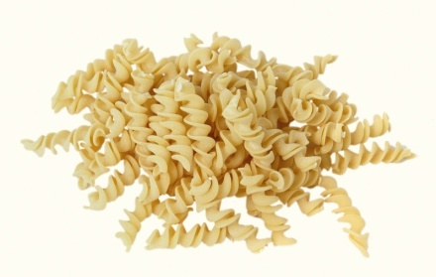
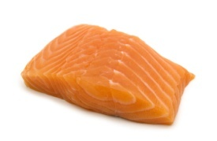
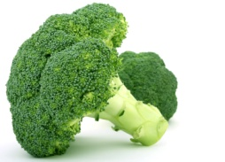
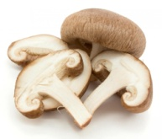
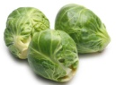
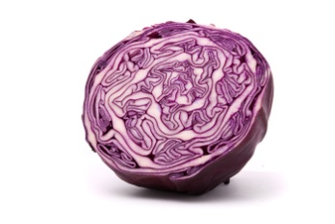
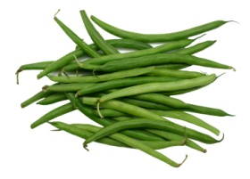
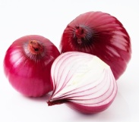
CREATE A BALANCED PLATE
Power-PACKED PROTEIN FOR MUSCLE REPAIR AND BUILDING
QUALITY CARBOHYDRATES FOR ENERGY
Fish
Chicken, turkey
Lean cuts of pork or beef
Low-fat dairy
(milk, yogurt, cottage
cheese, cheese)
Soy (tofu, soy milk,
edamame)
Beans, legumes
Nuts, seeds
Eggs
Potatoes/sweet potatoes
Brown rice
Whole grain pasta
Whole grain bread
Oatmeal/cereal
Fruit (fresh, frozen, or canned in fruit juice)
Tortillas
Corn
Butternut or acorn squash
Beans
Low-fat dairy (milk, yogurt)
Fats
Veggies for
ANTIOXIDANTS
HEALTHY fats for
cellular function
Spinach
Broccoli
Carrots
Tomatoes
Cauliflower
Asparagus
Peppers
Green beans
Olive oil
Canola oil
Avocado
Seeds (pumpkin, flax, chia, etc)
Nuts (almonds, walnuts, peanuts, pecans, etc)
Fatty fish (salmon, sardines)
Celery
Mushrooms
Cucumber
Cabbage
Eggplant

